Slide 1
Machine Learning

Slide 2
What is machine learning?
Notes:
Ask for students first thoughts. (avoid diatribes, though) If you want to and are familiar, briefly discuss history of the Perceptron (background image) https://en.wikipedia.org/wiki/Perceptron#History

Slide 3
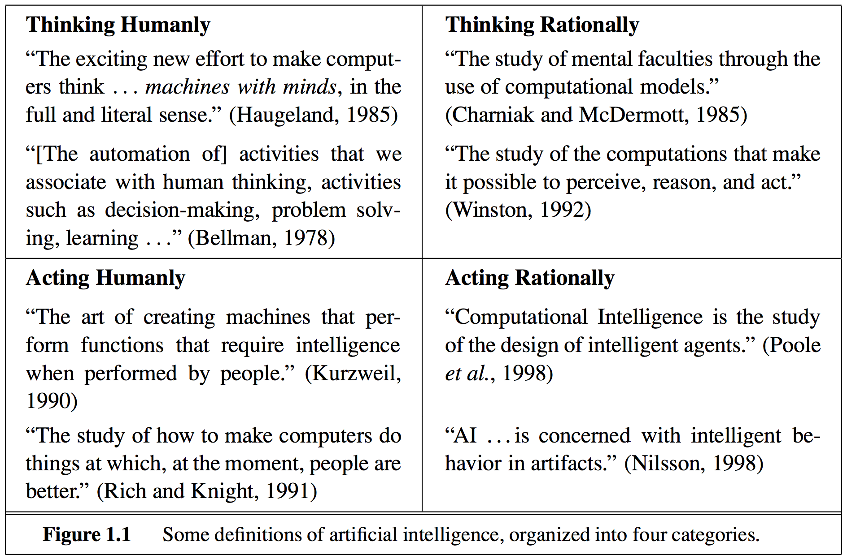
Machine Learning in context: AI
Russel & Norvig: Artificial Intelligence, A Modern Approach
Notes:
To define Machine Learning, let’s start with the broader category of Artificial Intelligence.
Here’s four general sentiments about what is and isn’t AI.
Table reproduced from Russel & Norvig Artificial Intelligence, A Modern Approach

Slide 4
Machine Learning in context: AI
Russel & Norvig: Artificial Intelligence, A Modern Approach
Notes:
When we talk about Machine Learning, we’re focusing on the thinking side of things.

Slide 5
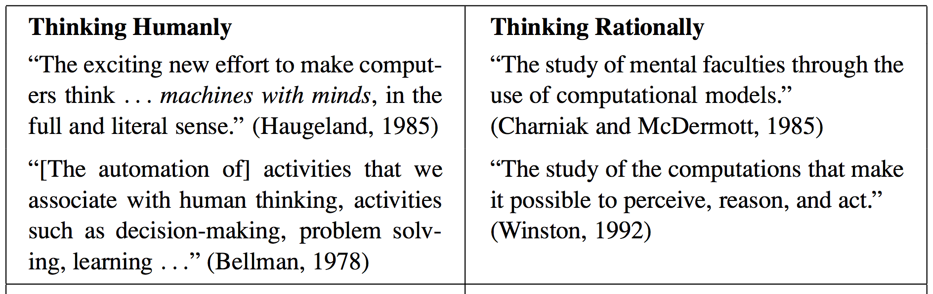
Machine Learning in context: AI
Russel & Norvig: Artificial Intelligence, A Modern Approach
Notes:
But even then, we only have some extremely slippery ideas to go off

Slide 6
Machine Learning in context: AI
Russel & Norvig: Artificial Intelligence, A Modern Approach
Notes:
Thinking, minds, decision making, perceiving, reasoning What precisely do these mean?
Let’s narrow them down to one idea: learning. We’ll define learning and then say that Machine Learning is just when machines learn.

Slide 7
What is learning?
Notes:
Ask for students first thoughts. (avoid diatribes, though) If you want to and are familiar, briefly discuss history of the Perceptron (background image) https://en.wikipedia.org/wiki/Perceptron#History

Slide 8
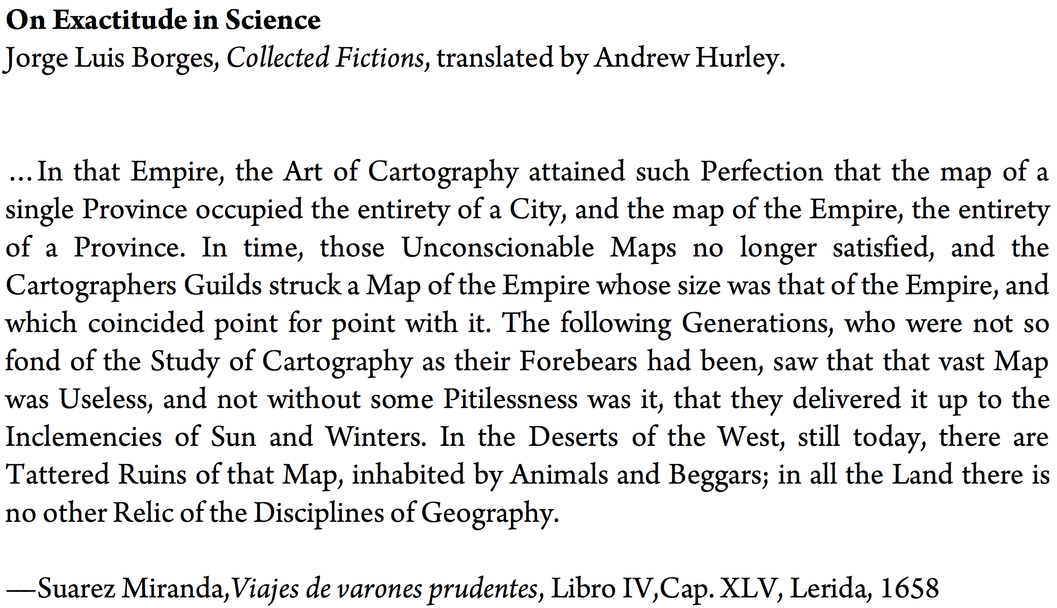
Notes:
This is a short story by Magical Realism author Jorge Luis Borges.
It won’t define learning for us but it might help us understand what is not learning.

Slide 9
Learn verb
\’lern\
to process past experience and update a model such that the the model is more useful for future experience
Notes:
It’s a lot of words. We’ll break it down

Slide 10
Learn verb
\’lern\
to process past experience and update a model such that the the model is useful for future experience
Notes:
Learning is forward looking. We’ll come back to this idea when we discuss cross validation.

Slide 11
Learn verb
\’lern\
to process past experience and update a model such that the the model is useful for future experience
Notes:
More on what a model is in the next slide.
Important point is that how Machine Learning models “remember” depends on how we set up the representations.

Slide 12
Learn verb
\’lern\
to process past experience and update a model such that the the model is more useful for future experience
Notes:
Finally, machine learning models are designed to be useful. We’ll spend a lot of time defining and thinking about how we measure usefulness. How we put a number on it.

Slide 13
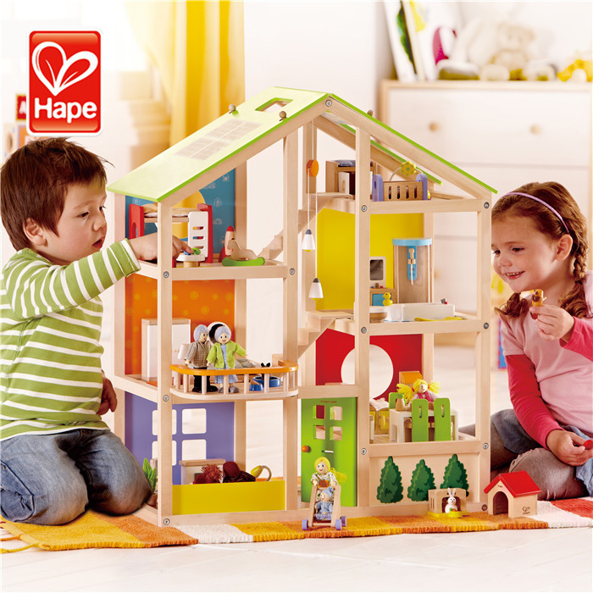
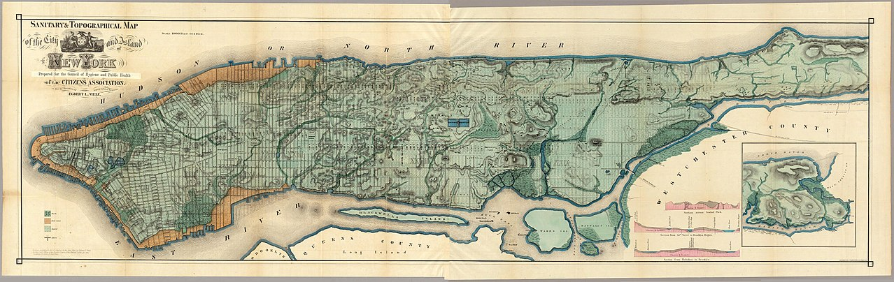
Model: a learning algorithm
A model is a small thing that captures a larger thing.
A good model omits unimportant details while retaining what’s important.

Slide 14
Model: a learning algorithm
Industry sometimes uses “algorithm” and “model” interchangeably.
Words are complicated (more on this in project 4)

Slide 15
How does machine learning work?

Slide 16


ML framework
Applies to every machine learning model
You should eventually be able to explain what $y_{p}, f, Ω,$ and $x$ are for every model we cover in the bootcamp.
Notation:
$x$ and $y$ are arrays with 1 or more rows and columns. A single example is just an array with 1 row. A single feature is just an arrow with 1 column.
$Ω$ is standing in for 1 or more variables, rather than a single variable.
$$y_{p}=f(Ω, x)$$

Slide 17
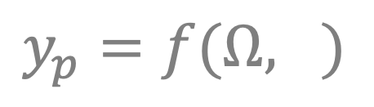

ML framework
Applies to every machine learning model
$x$ : Input
Observations: rows or examples the model will see.
Features: the different ways that we measure each observation
What were the observations and features in the MTA challenge?
$$y_{p}=f(Ω, x)$$

Slide 18
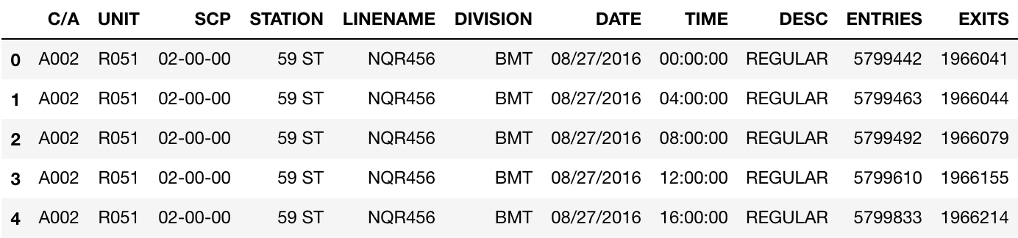
ML framework
Applies to every machine learning model
$x$ : Input
Observations: rows or examples the model will see.
Features: the different ways that we measure each observation
What were the observations and features in the MTA challenge?
$$y_{p}=f(Ω, x)$$

Slide 19

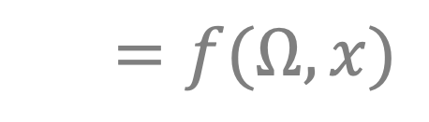
ML framework
Applies to every machine learning model
$x$ : Input
$y_{p}$ : Output
Be careful to keep separate $y_{p}$ (the prediction of our model) and $y$ (the observed values of y).
Regression: y is numeric
$$y_{p}=f(Ω, x)$$
Notes:
Ask for examples of regression

Slide 20

ML framework
Applies to every machine learning model
$x$ : Input
$y_{p}$ : Output
Be careful to keep separate $y_{p}$ (the prediction of our model) and $y$ (the observed values of y)
Regression: y is numeric
Stock price, customer churn, location (x,y coordinates)
$$y_{p}=f(Ω, x)$$

Slide 21

ML framework
Applies to every machine learning model
$x$ : Input
$y_{p}$ : Output
Be careful to keep separate $y_{p}$ (the prediction of our model) and $y$ (the observed values of y)
Regression: y is numeric
Stock price, customer churn, location (longitude, latitude)
Classification: y is categorical
$$y_{p}=f(Ω, x)$$
Notes:
Ask for examples of classification

Slide 22

ML framework
Applies to every machine learning model
$x$ : Input
$y_{p}$ : Output
Be careful to keep separate $y_{p}$ (the prediction of our model) and $y$ (the observed values of y)
Regression: y is numeric
Stock price, customer churn, location (x,y coordinates)
Classification: y is categorical
Face recognition, winner of award, which word comes next
$$y_{p}=f(Ω, x)$$

Slide 23
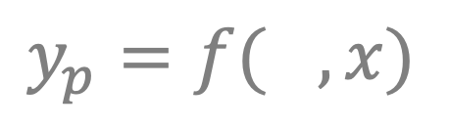

ML framework
Applies to every machine learning model
$x$: Input
$y_{p}$: Output
$Ω$: Parameters
This is what changes as the model learns.
Some models have many different parameters, some have very few.
Hyper-parameter: A parameter that is not learned directly from the data.
Later we will discuss techniques for using model performance to inform hyperparameter selection.
$$y_{p}=f(Ω, x)$$

Slide 24
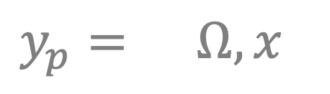

ML framework
Applies to every machine learning model
$x$: Input
$y_{p}$: Output
$Ω$: Parameters
$f(⋅)$: Prediction function
Generates predictions from $x$ and $Ω$
$$y_{p}=f(Ω, x)$$

Slide 25

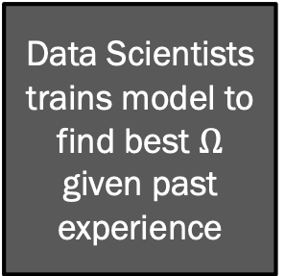
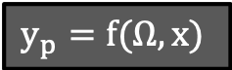


ML framework
X
X
X
X
X
X
X
X
X
X
X
Data Scientists trains model to find best $Ω$ given past experience
$$y_{p}=f(Ω,x)$$
y
y
y
y
y
y
$$y_{p}$$
$$y_{p}$$
$$y_{p}$$
$$y_{p}$$
$$y_{p}$$
time

Slide 26

ML framework
Applies to every machine learning model
$x$: Input
$y_{p}$: Output
$Ω$: Parameters
$f(⋅)$: Prediction function
Applies to most machine learning models
$J(y,y_{p})$: Loss
Most ML models define a quantitative score for how “good” our predictions are.
Typically measures how close our predictions are to the true values.
$$y_{p}=f(Ω, x)$$

Slide 27

ML framework
Applies to every machine learning model
$x$: Input
$y_{p}$: Output
$Ω$: Parameters
$f(⋅)$: Prediction function
Applies to most machine learning models
$J(y,y_{p})$: Loss
Update rule:
Given observed $y,x$, the update rule determines how to update $Ω$
Typically, finds the $Ω$ that minimizes $J(y,f\left(Ω,x\right))$
$$y_{p}=f(Ω, x)$$

Slide 28

ML framework
Applies to every machine learning model
$x$: Input
$y_{p}$: Output
$Ω$: Parameters
$f(⋅)$: Prediction function
Applies to most machine learning models
$J(y,y_{p})$: Loss
Update rule
$$y_{p}=f(Ω, x)$$

Slide 29
What can we do with Machine Learning?

Slide 30

Two common approaches
Interpretation
In some cases, the primary concern what the model tells us.
In $y_{p}=f(Ω, x)$, the interpretation approach uses $Ω$ to give us insight into a system.
Example workflow:
Gather $x,y$
Train a model by finding the $Ω$ that gives the best prediction $y_{p}=f(Ω, x)$
Discard $y_{p}$. Peer into $Ω$ and see what it tells us.

Slide 31
Two common approaches
Interpretation
Example: Looking for insight into housing sale prices in Ames, Iowa. Which features are most important?

Slide 32

Two common approaches
Interpretation
Prediction
AKA “bake off”
In some cases, the primary concern is making the best prediction.
The focus is on optimizing certain performance metrics, such as accuracy or $r^{2}$ (more on this later).
ex: Kaggle, KDD Cup
Black box model: A model with little-to-no interpretability.

Slide 33
Two common approaches
Interpretation
Prediction
Example: Build an app that predicts the eventual sale price of homes in Ames, Iowa.

Slide 34
Two common approaches
Interpretation
Prediction
Combined
Majority of projects will call for a balance.
Interpretation can provide insight into improvements in prediction and vice-versa.

Slide 35

Takeaways
Machine Learning is the subset of AI that focuses on model building
ML algorithms
Use past experience to update a model that is useful for future experience.
Follow a general form: $y_{p}=f(Ω, x)$
Models can be used for interpretation and/or prediction

